Slide 1

Anomaly Detection in File Access Patterns
Ricardo Machado
NMEC : 102737

Slide 2
WHY MONITOR FILE ACCESS?
Motivation: Data security is crucial in corporate networks, where unauthorized file access can lead to data breaches, financial losses, and reputational damage, making anomaly detection a crucial security measure
Example: In 2022, more than 30% of companies suffered internal attacks that exposed sensitive data
Objective: Implement a system to detect anomalous access patterns effectively, helping to prevent threats

Slide 3
DATA SOURCES
Acquisition of Google Drive usage data captures from users with two different profiles: student and teacher
Bot script development to access Google Drive (basic and advanced )
Basic: simple simulation with a fixed time interval
Advanced: introduces more randomness and unpredictability

Slide 4
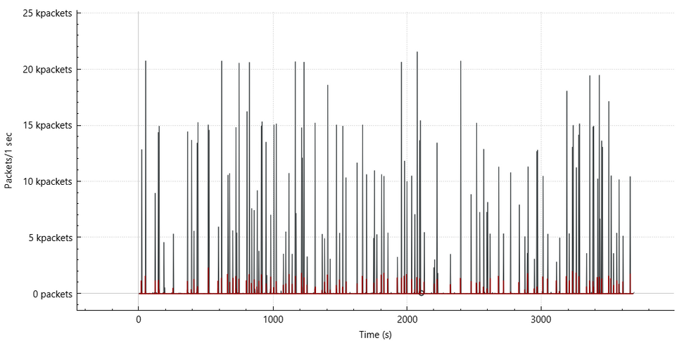
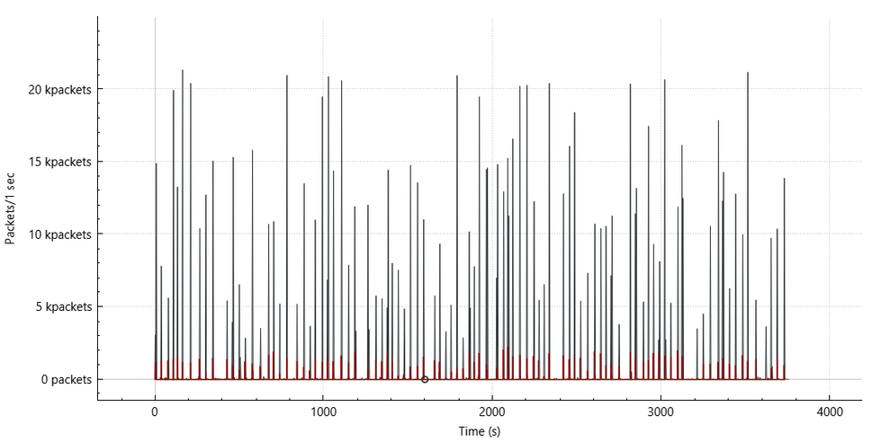
WIRESHARK I/O GRAPHS FROM BOTH BOTS
Basic Bot
Aggressive and irregular spikes
Easier Detection - abnormal spikes
Advanced Bot
More balanced and controlled
Harder Detection - disguised

Slide 5
METRICS EXTRACTED
FEATURES TO EXTRACT
Number of packets for upload and download
Volume of bytes for upload and download
For each metric defined:
Mean, median, standard deviation
Percentiles(75%/80%/90%/98%)

Slide 6
TRAINING AND TEST FEATURES
Initial approach
Train using 70% of each user's features (student & teacher)
Test on the remaining 30% of user features (same users)
Test on bot features(Basic and Advanced bots)
Second approach
Train using 50% of each user's features (student & teacher)
Test on the remaining 50% of user features (same users)
Test on bot features(Basic and Advanced bots)

Slide 7
ANOMALY DETECTION TECHNIQUES USED
Statistical Analyses:
Centroids distances
Centroids distances with PCA features
Multivariate with PCA features
Machine Learning:
One Class Support Vector Machine (Linear, RBF and Poly Kernels)
One Class Support Vector Machine with PCA features (Linear, RBF and Poly Kernels)
Anomaly Detection:
Isolation Forest with PCA features
Isolation Forest without PCA features

Slide 8
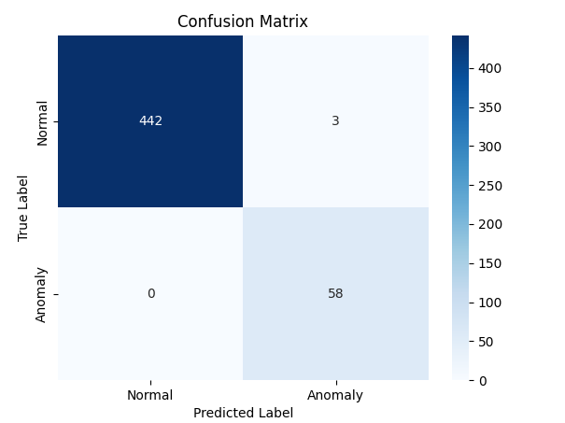
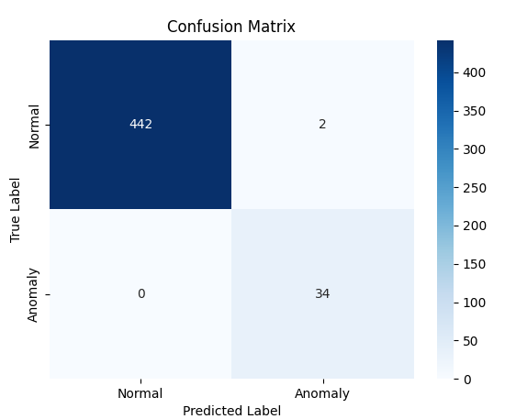
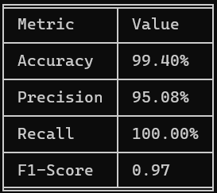

BEST RESULTS FROM INITIAL APPROACH
Isolation Forest with PCA
Basic Bot
Advanced Bot

Slide 9
CONCLUSION FOR INITIAL APPROACH
The Isolation Forest model, when using PCA-transformed features, proves to be the most effective in identifying anomalies across all bot traffic in the dataset

Slide 10
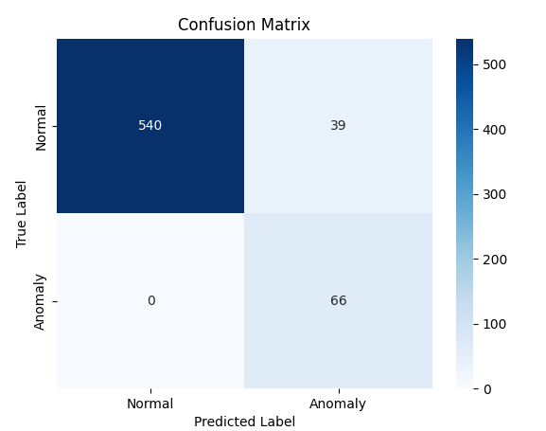
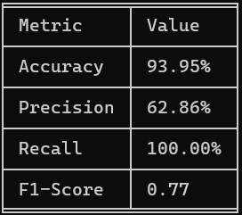
BEST RESULTS FROM SECOND APPROACH
Multivariate with PCA

Slide 11
CONCLUSION FOR SECOND APPROACH
The most effective models is Multivariate with PCA achieving an F1-score of 77%.

Slide 12
CONCLUSION
The Isolation Forest model with PCA features proves to be the most effective in detecting anomalies across different bot behaviors
Multivariate analysis perform well when analyzing activity-based features
The user-based approach yields more consistent results, suggesting that user similarity plays a crucial role in anomaly detection

Slide 13
Thank you!

